Slide 1
Property Values vs
Quality Of Life?
Do higher housing prices reflect a safer/quieter neighborhood?
A look into the last decade of San Francisco’s population growth

Slide 2
Are housing prices affected by adverse quality of life issues?
Are there significant differences among different neighborhoods?
Have issues affecting different neighborhoods changed over the years?

Slide 3
General Insights
As of 2018, San Francisco had an estimated population of 883,000 people. Since the last US Census in 2010, the City has experienced over 10% in population growth. How has this population affected different neighborhoods? Our analysis was limited to four different metrics: Housing Prices, Policy Activity, Fire Activity and General Citizens Complaints (311).
Houses prices have increased in all neighborhoods.
Police activity has remain fairly steady
311 complaints have increased dramatically
Fire activity has increased significantly (due to a large increase in medical calls)

Slide 4
What is a neighborhood?
In DataSF, there are multiple definitions of neighborhoods:
Analysis Neighborhoods (41)
Realtor Neighborhoods (89)
Planning Neighborhoods (38)
Supervisor Districts (11)
In order to get a more significant set of data per neighborhood, we selected the Supervisor Districts for our analysis. Because these Districts are supposed to include the same number of citizens, it provides the best way to compare trends between neighborhoods.

Slide 5
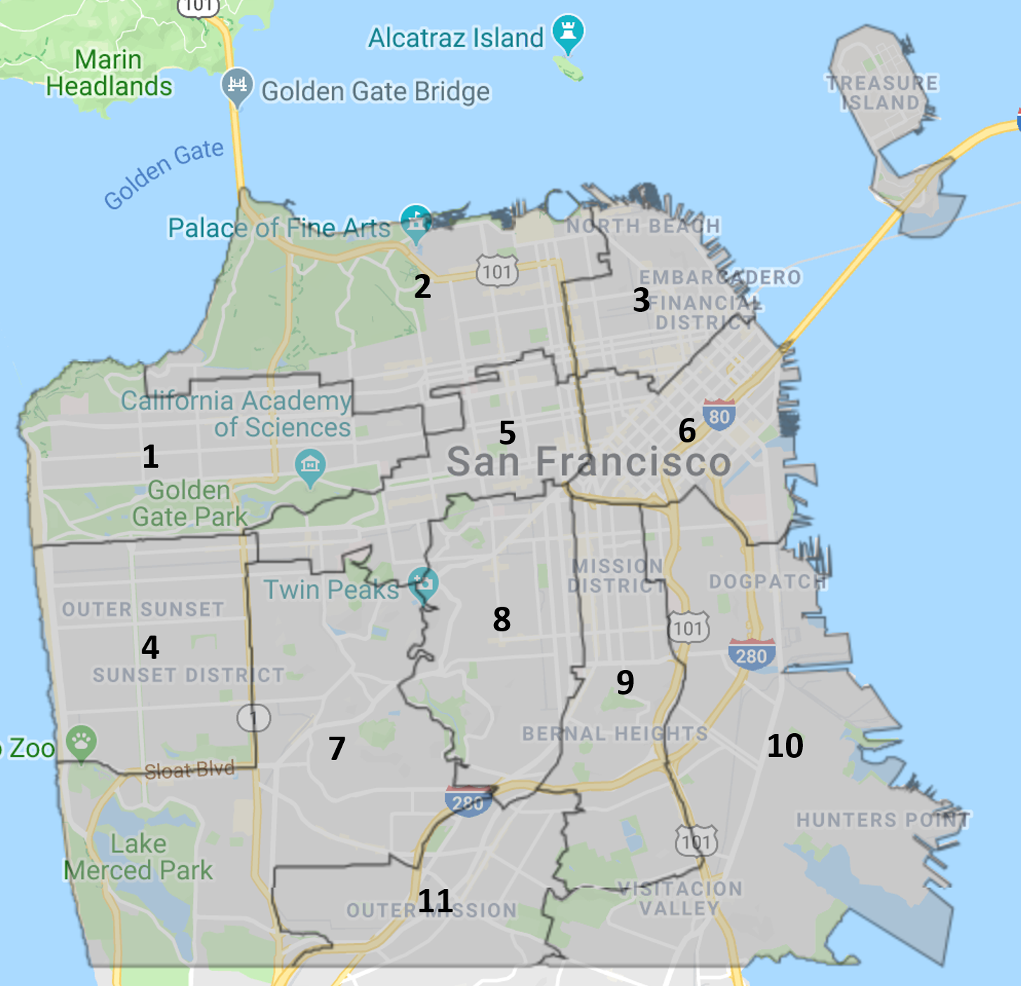
San Francisco Supervisor Districts
(Based on 2000 Census)

Slide 6

To gather this data, big thanks to the City of San Francisco for their impressive Data SF portal and datasets

Slide 7
In DataSF, we found datasets for:
Property Tax Rolls from 2006-2017
SFPD Calls For Service since 2008
Citizen Complaints (311)
SFFD Calls For Service since 2006

Slide 8
Challenges
It is wonderful that so much data is available online. However, we spent a significant amount of time not just analyzing the data but cleaning the data!
The Tax Collector data included many records with null values for critical fields (like Last Date Sale or Construction Year). Also, some data was clearly inconsistent and could not be used.
All data sets included fields with mixed type values (i.e. integers or dates mixed with plain text data)
Looking at 10 years of multiple data sets required spending a lot of time downloading data and processing the data.

Slide 9
Property Values By District
Because of CA Proposition 13, property values are only re-assessed after the property has been sold. So, we can only evaluate increased in property values on properties that were sold in a given year.
The Date of Sale value had inaccurate data. Surprisingly, not only records with sale prices before 2000 were unreliable (Year 2K Problem), but records sold before 2010 had also problems.
In order to determine properties sold in a particular year, we compared the tax value of the same parcel for two consecutive years. Those with an increase in value greater than 3% were clearly new sales.
In order to provide a consistent way to compared properties, study only includes Dwellings, Condominiums and Live/Work Condominiums. This group includes over 70% of property sales.

Slide 10
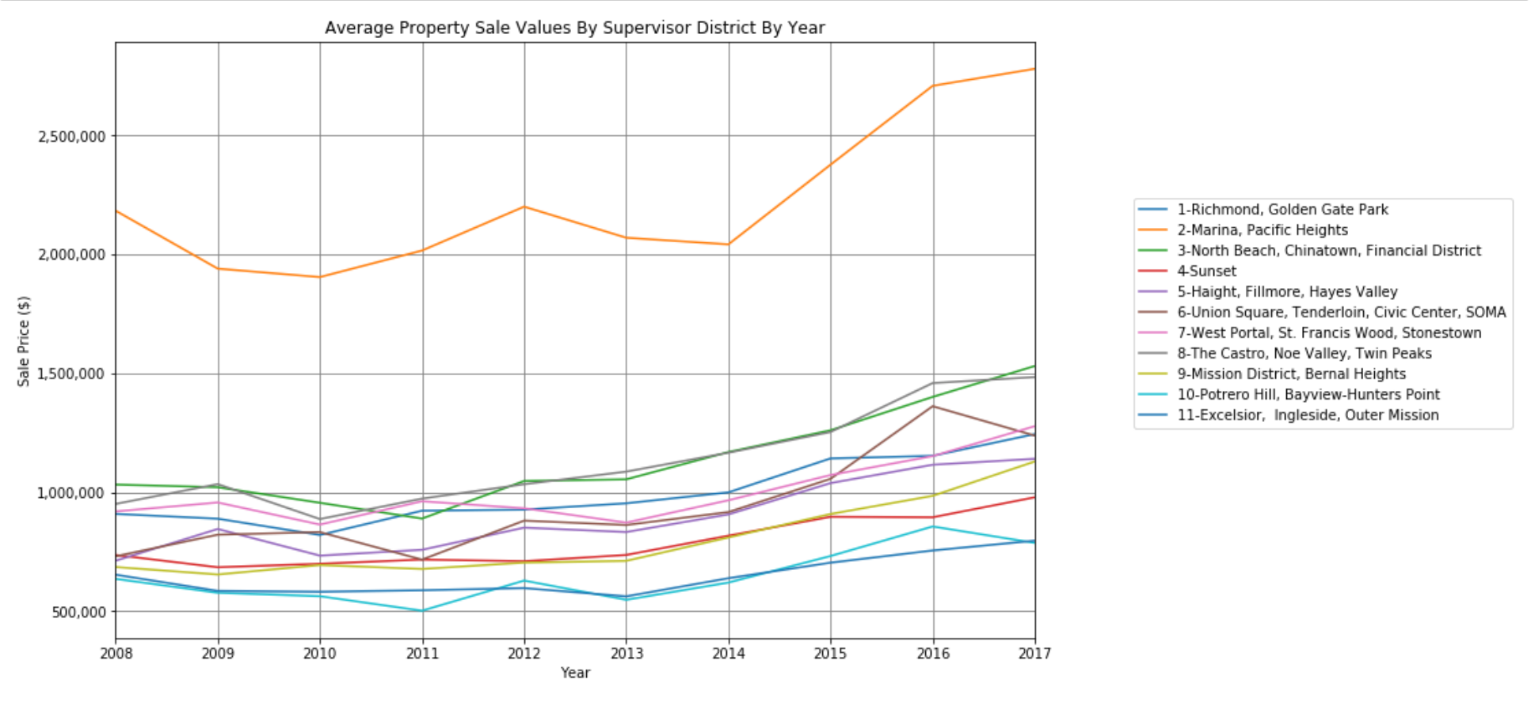
Property Value Trends By District

Slide 11
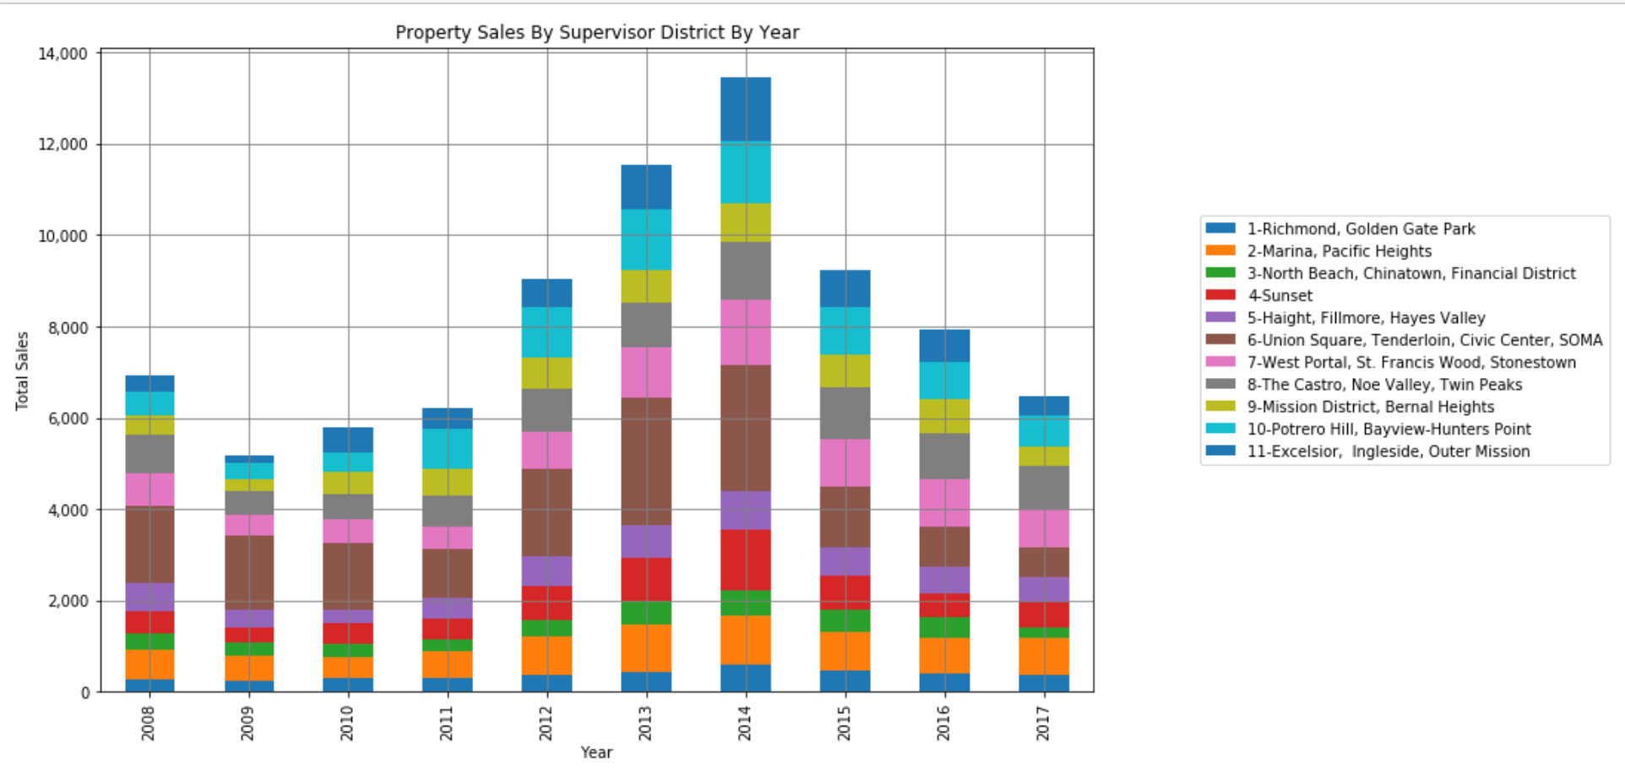
Property Sales By Year

Slide 12
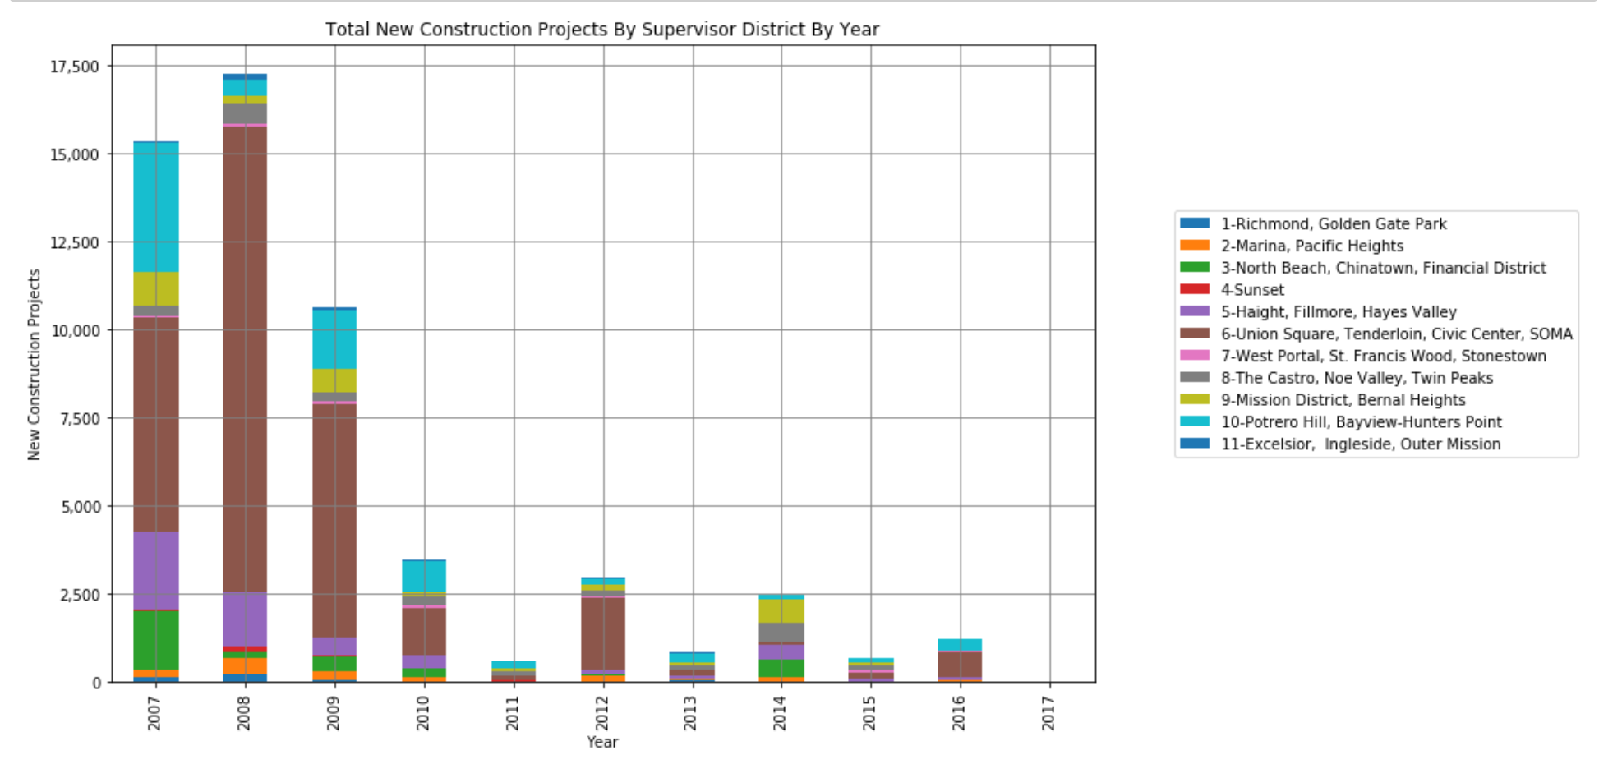
New Construction Projects By Year

Slide 13
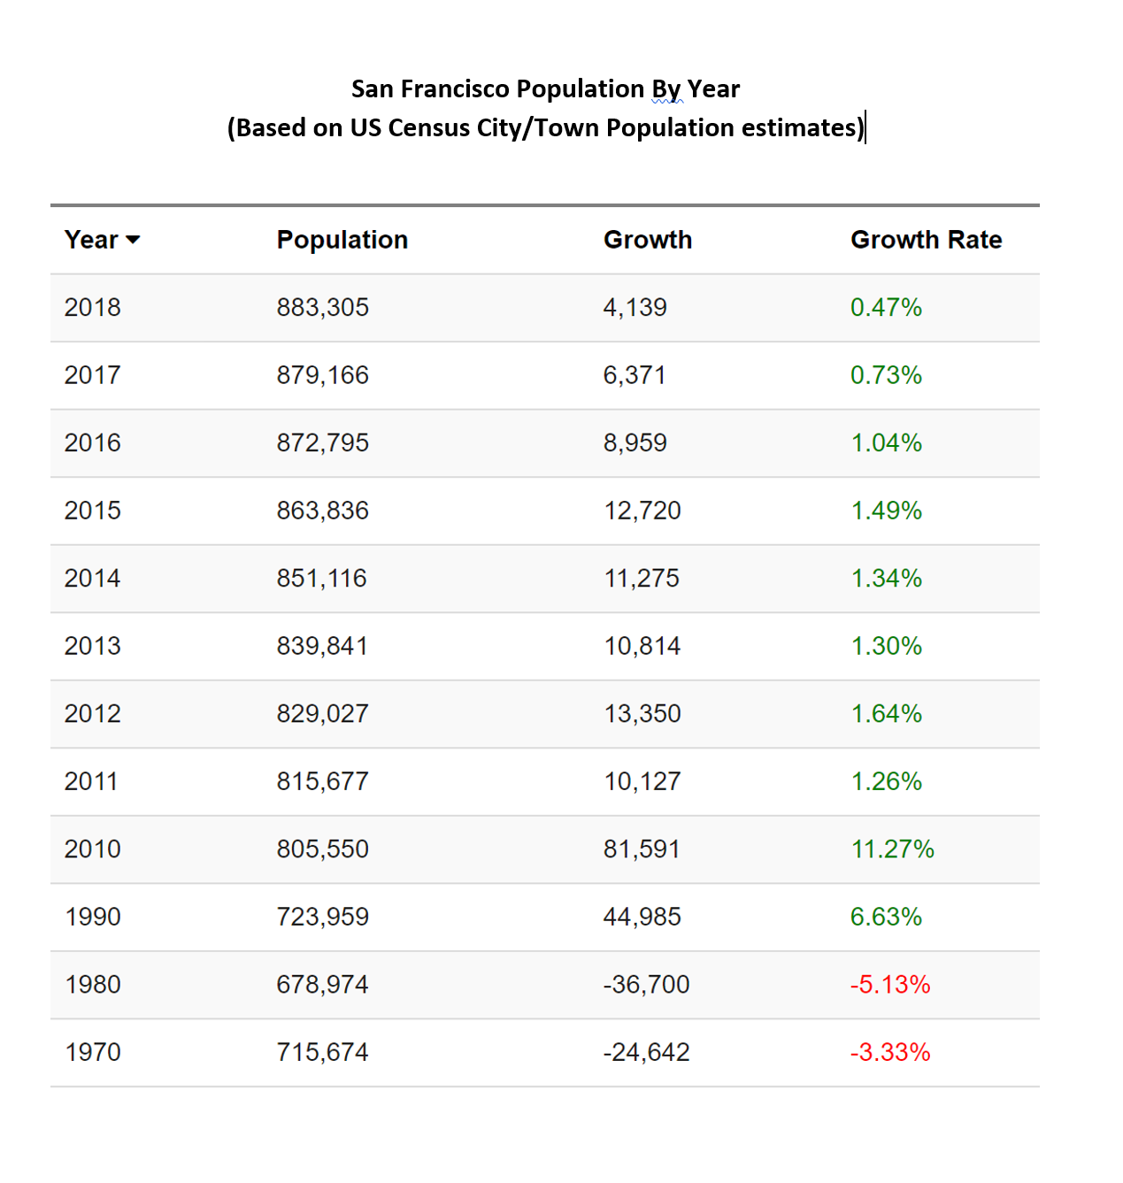
Are the new construction numbers for 2007-2008 possible?
Based on historic population numbers, San Francisco had a large increase in population during the 2000-2010 period

Slide 14
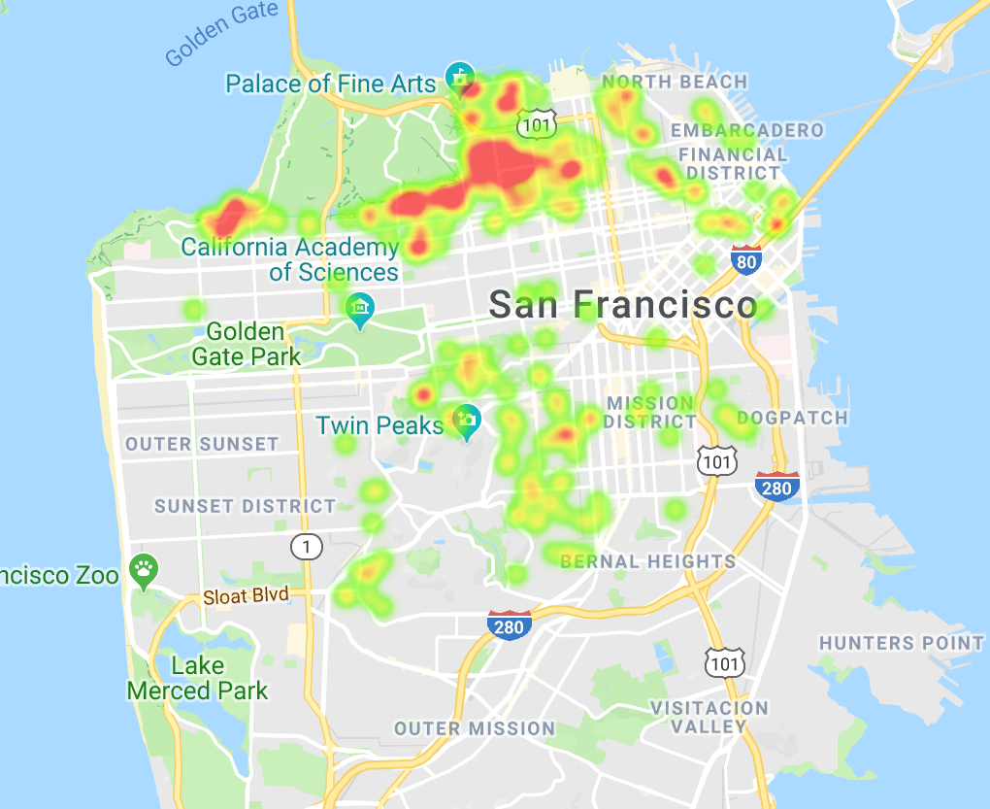
Heat Map: Location of High Value Properties

Slide 15
Observations Based on Property Sales Data
District 2 (Marina/Presidio/Sea Cliff) has, by far, the highest average property prices of all Districts. Overall property values in this District are about 2.12 times more expensive than the average property in the City.
Districts 5, 6, 9 (SOMA, Mission, and Hayes Valley) experienced the greatest increase in average property values for the period considered. District 6 also had the greatest number of property sales in the years 2012-2015.
Districts 10 and 11 (Bayview, Ingleside, Outer Mission) have the lowest overall prices and experienced the lowest increase in property values. Properties in these districts are about 0.60 times less expensive than the average property in the City.

Slide 16
Police Department Calls By District
Defining Crime:
Crime number has been steady for 2006-2016 period
Highest increase is in the Marina (30% from 2006 - 2016)
Highest increase is in SOMA (60%)
Overall, district 10 has the highest crime rate (Bayview and Portrero hills)
Overall, district 7 has the lower crime rate (Outer mission)

Slide 17
District with the most crime / district with the least crime

Slide 18
Citizen Complaints (311 Calls) By District
We analyzed the 311 Call Data by District and Year
We also looked at the different Complaints Type by Year.
Converting Date/Time data to Year in order to better group the results was very challenging.
The number of complaints per year increased significantly in the 2006-2016 period.

Slide 19
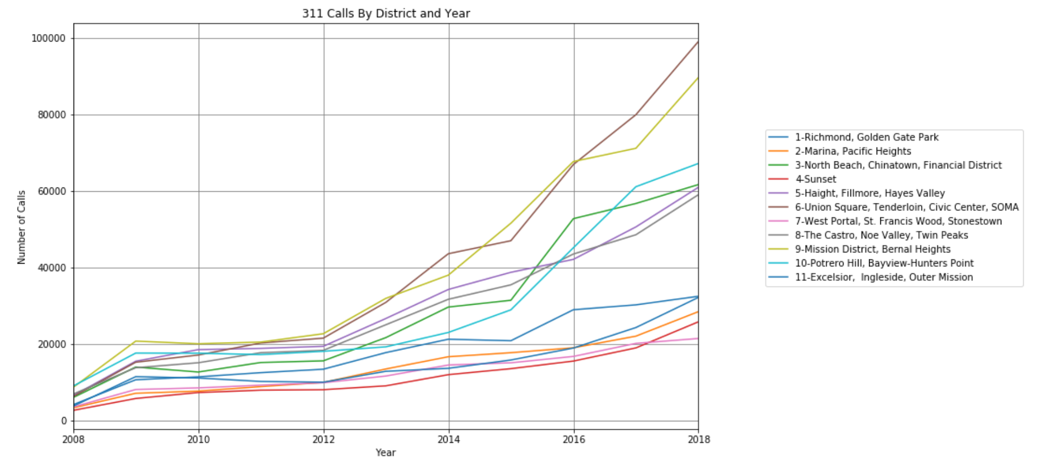
Citizen Complaints (311 Calls) By District

Slide 20
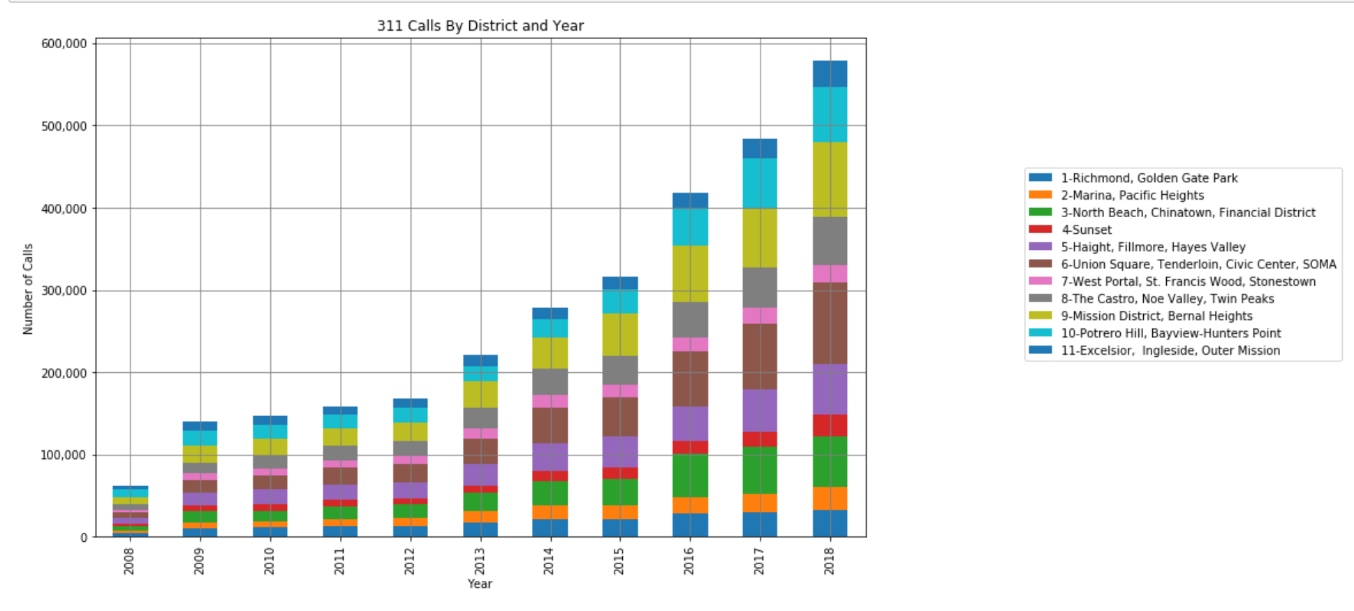
Citizen Complaints (311 Calls) By District

Slide 21
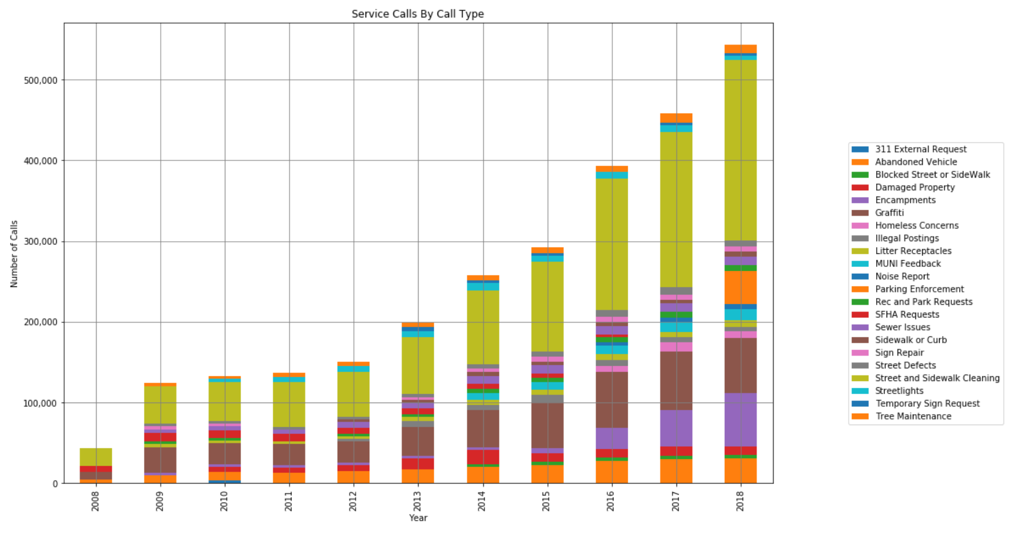
Citizen Complaints by Category

Slide 22
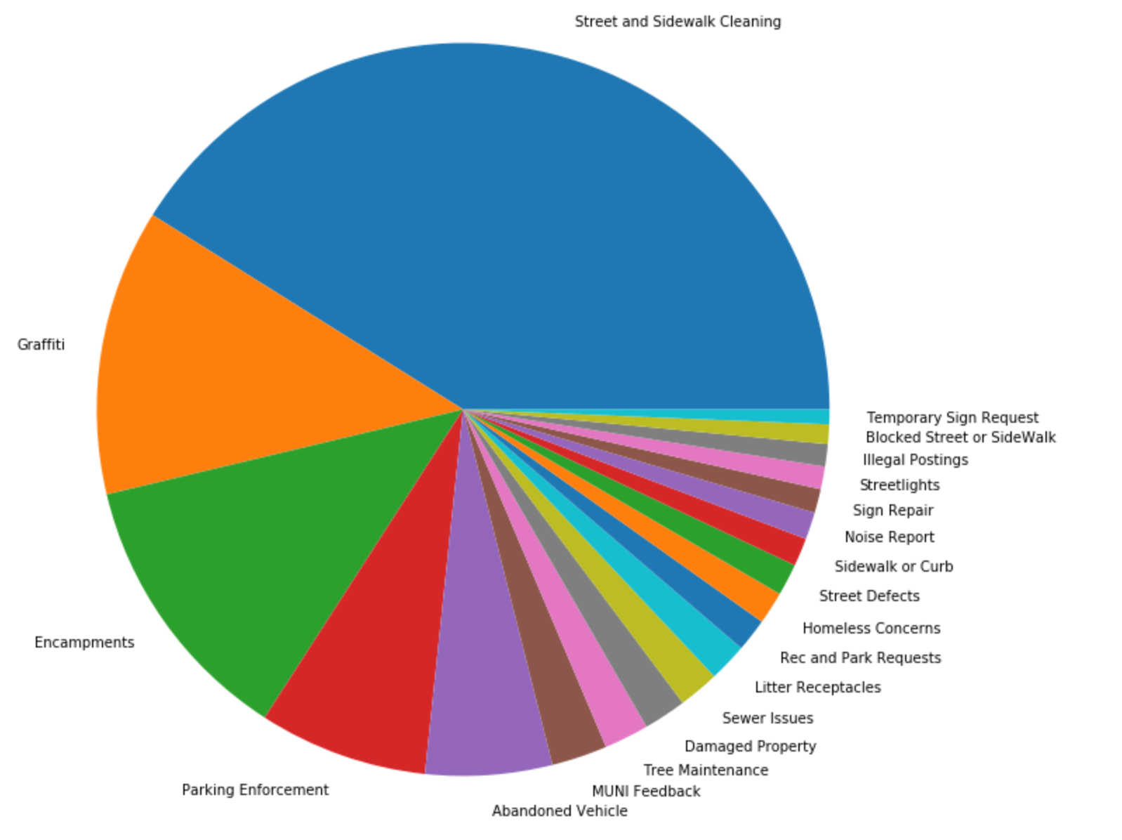
Citizen Complaints by Category (2018)

Slide 23
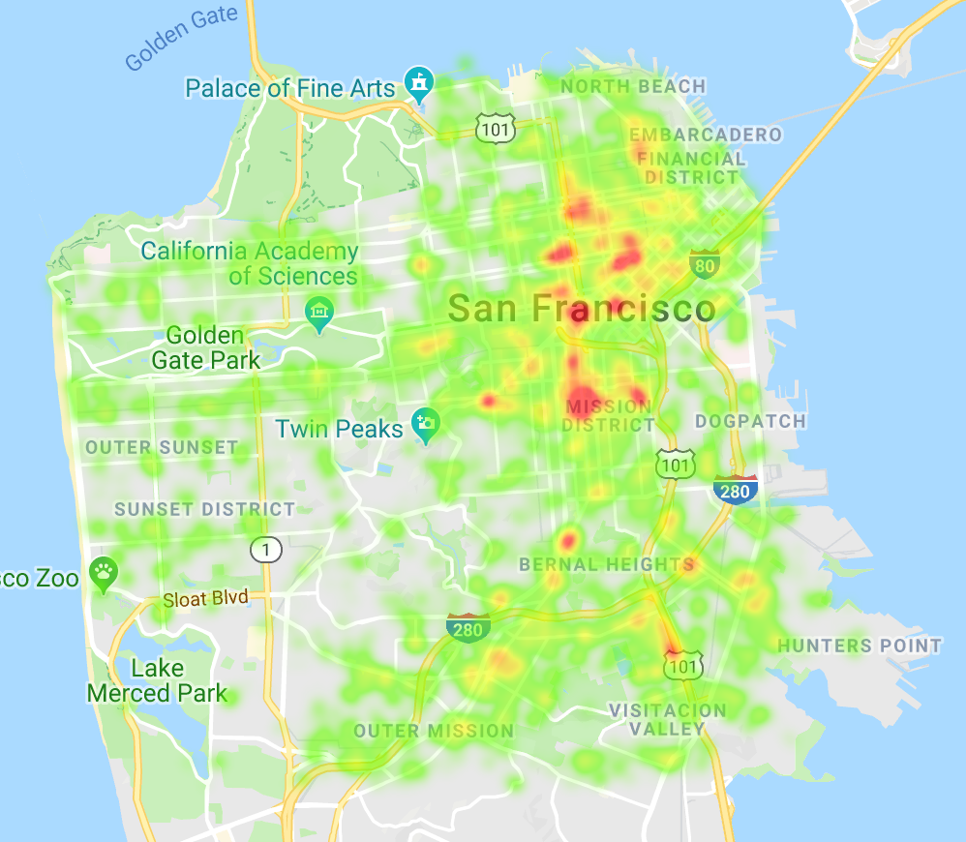
Heat Map: Location of 311 Calls (2018)

Slide 24
Citizen Complaints (311 Calls) By District
Overall, District 6 (SOMA) has the highest number of complaints per year.
District 6 also has the greatest increase in calls year after year. The number of calls in 2018 were 15.64 times greater than in 2008.
Overall, District 7 (West Portal) has the lowest number of complaints.
By far the largest share of complaints is for Street Cleaning.
Homeless Encampments and Grafitti are the second most type of service request as of 2014.

Slide 25
Fire Department Calls By District
Large data set (1.94 GB)
Removed duplicate Incident Numbers and converted a DateTime column into a Year column
Analyzed the Fire Department Call Data by District and Year
Looked at the different Call Type Groups by Year
The number of calls per year increased significantly in the 2012-2018 period

Slide 26
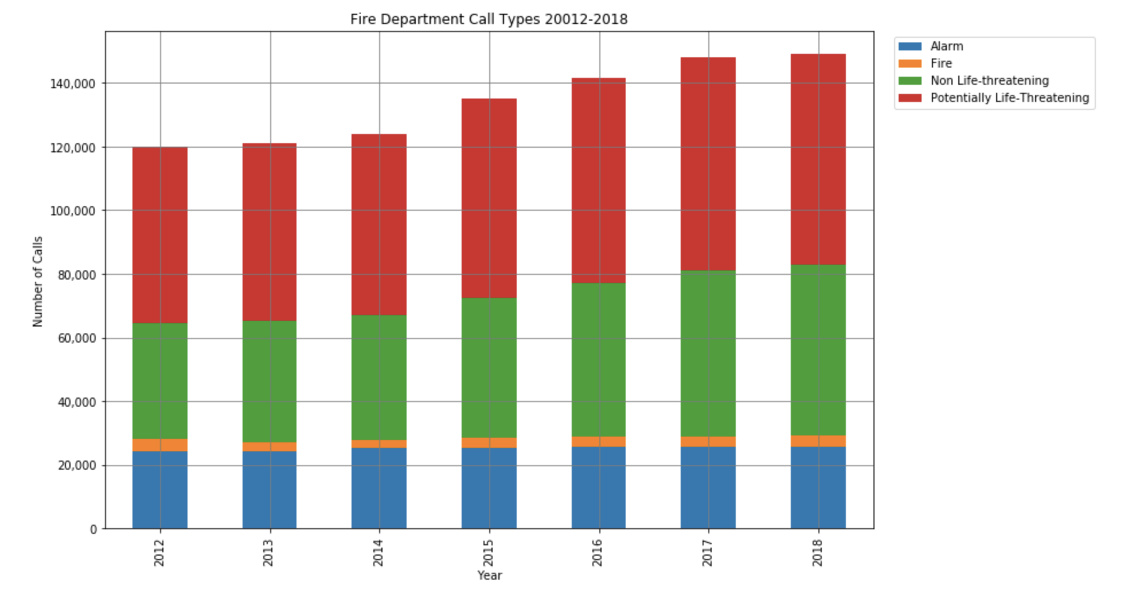
Fire Department Calls By Year

Slide 27
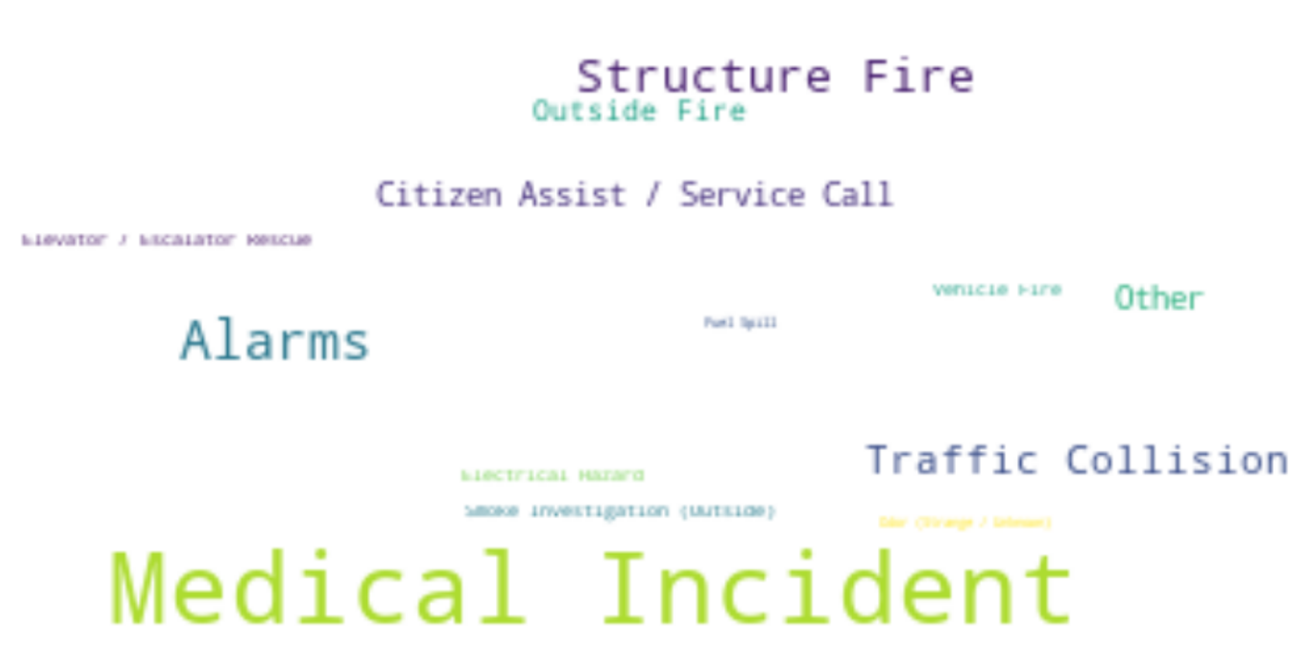
Fire Department Calls By Category

Slide 28
Fire Department Calls By District
Medical Incidents are the top reason for Fire Department calls.
Over time, fire department calls have been increasing in Non Life-Threatening and Potentially Life-Threatening categories.
Alarm and Fire calls have remained steady.
Most Fire Department calls are in Districts 3, 5, and 6

Slide 29
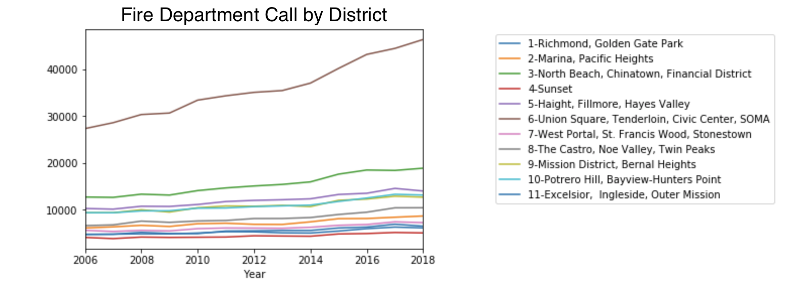
Fire Department Calls by District

Slide 30
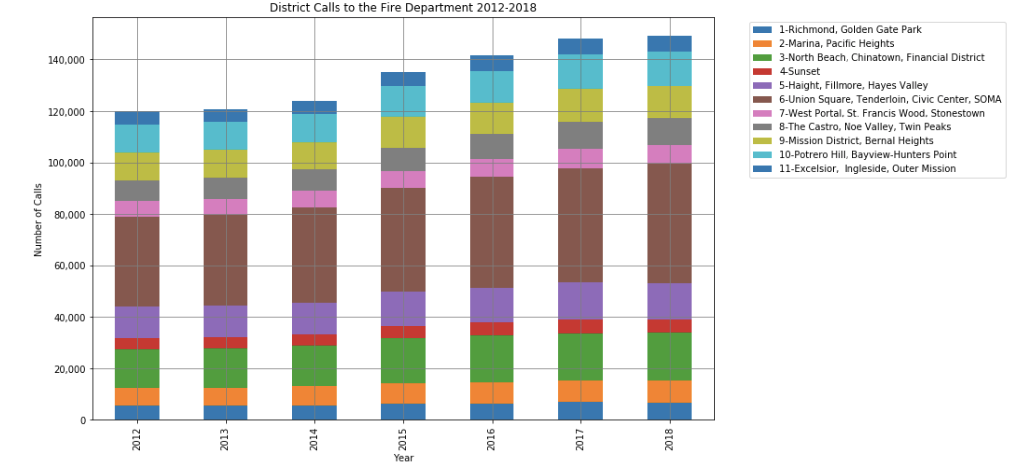
Fire Department Calls by District

Slide 31
District 6 (most fire) compared to District 6 in crime
District 6 has had an x% amount of increase in over time
311 calls have been increasing
Crime has been steady
Housing has increasing so Fire Department Calls and calls do not affect housing price (since this had the greatest increase)
Pic of the 311 Calls increasing
Pic of Crime being steady
Pic of District 6 Housing Price Trend) which is high

Slide 32
District 6 (most fire) compared to District 6 in crime
DO SAME ANALYSIS FOR MISSION AREA
District 6 has had an x% amount of increase in over time
311 calls have been increasing
Crime has been steady
Housing has increasing so Fire Department Calls and calls do not affect housing price (since this had the greatest increase)
Pic of the 311 Calls increasing
Pic of Crime being steady
Pic of District 6 Housing Price Trend) which is high

Slide 33
Price of houses where the most crime occur
Price of houses where the less crime occur

